Slide 1

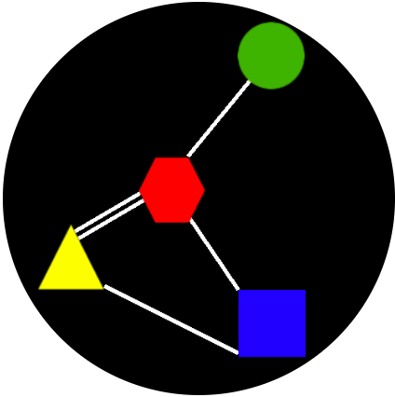
Ryan Basso
Cheng Li

Slide 2
NODE KONNECTOR (Overview)
Node connector is a logic based puzzle game, in which the users can…….
Pick a level
Select a node
Bond the nodes
Check for winning!
Save your level progress locally, or, over Facebook!

Slide 3
Why Node Konnector? (Innovation)
Logic-based puzzle Game
Fun pastime
Targeted audience:
Chess, sudoku, puzzle, maze-solving, crossword, enthusiasts
Anyone with VOPOFROB Syndrome (Verge-Of-Passing-Out-FROm-Boredom)
Anyone with a particularly strong (if not strange) affection for green circles, yellow triangles, blue squares, red hexagons, or white/purple lines
Chuck Norris
Let’s....konnect the nodes!

Slide 4
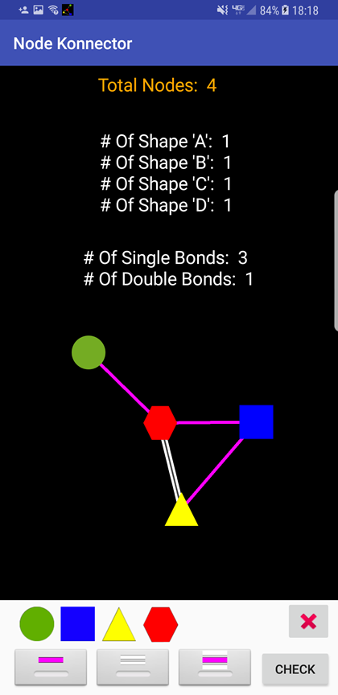
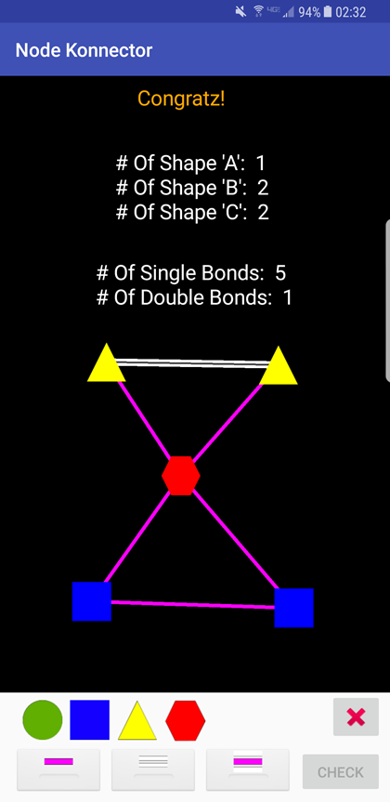
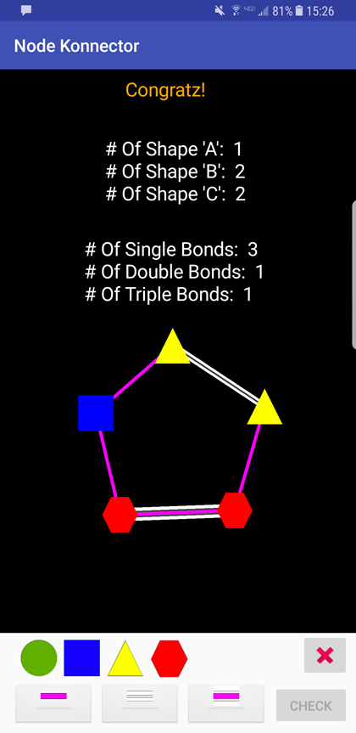
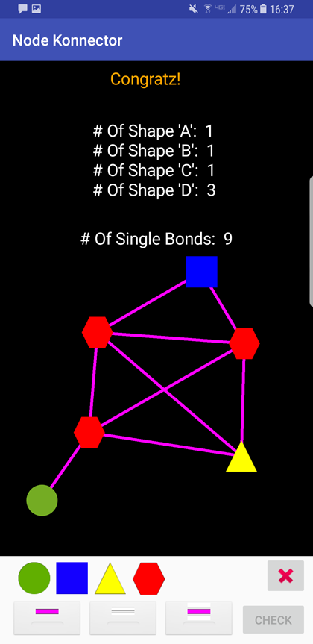
Sample Winning Structures

Slide 5
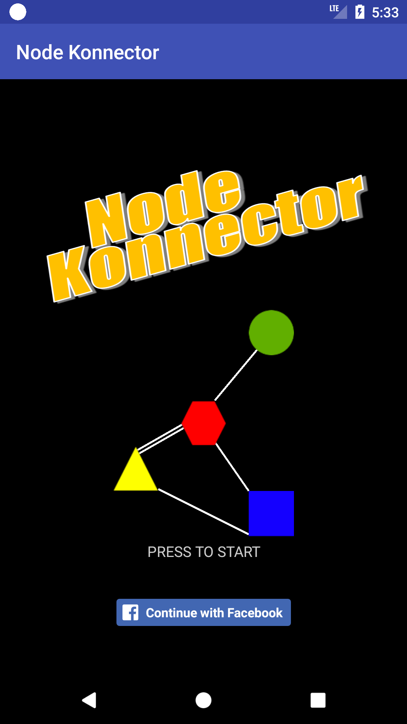
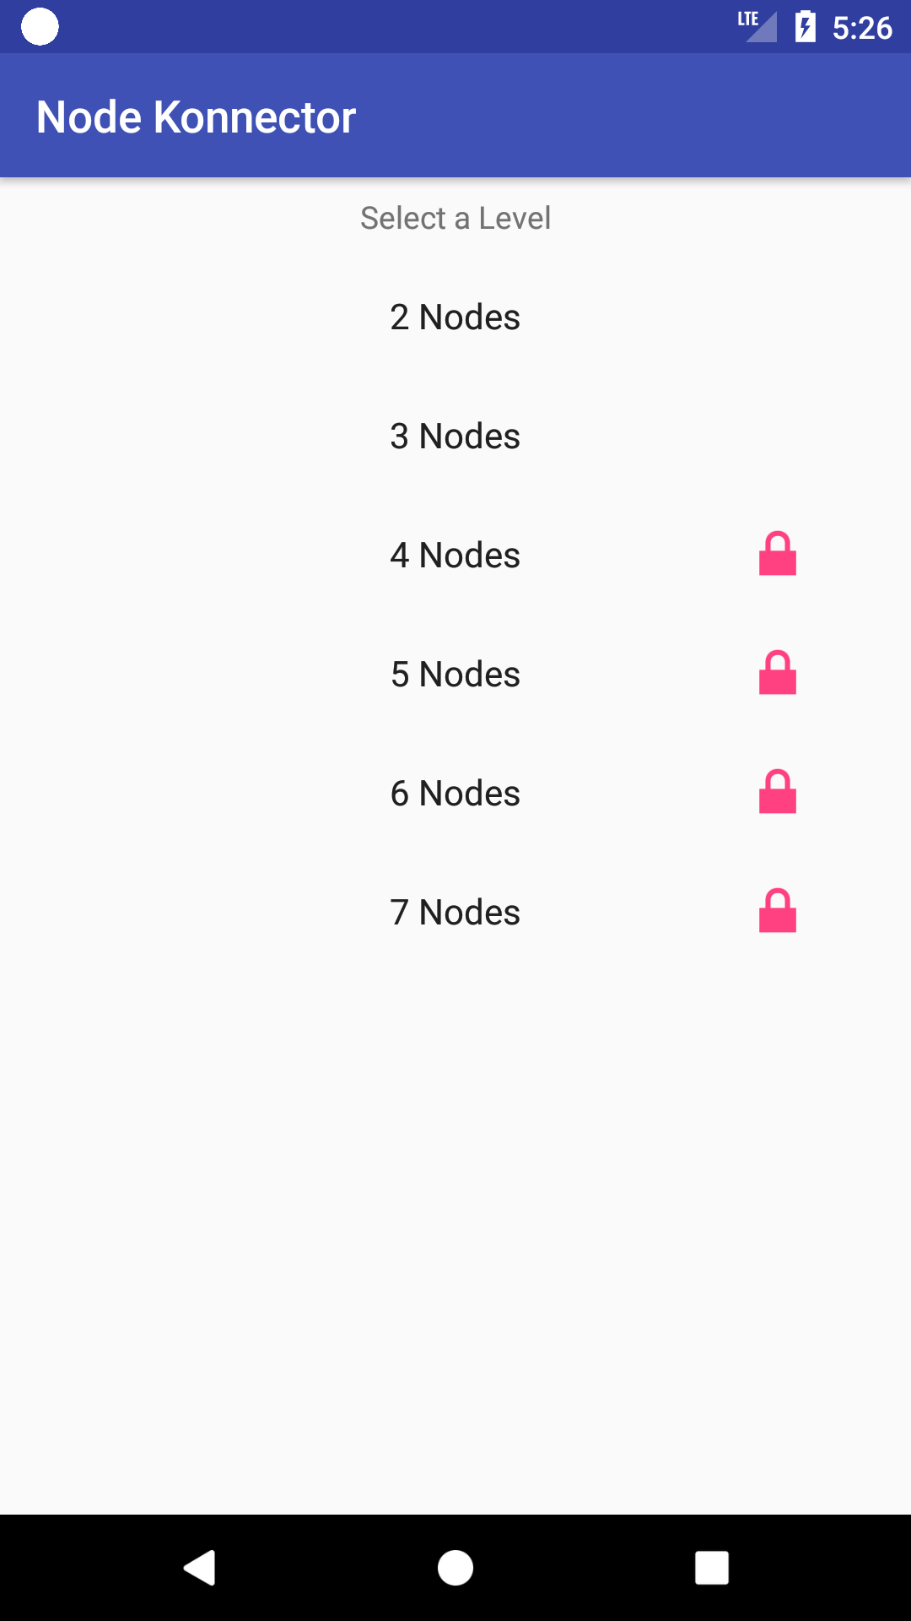
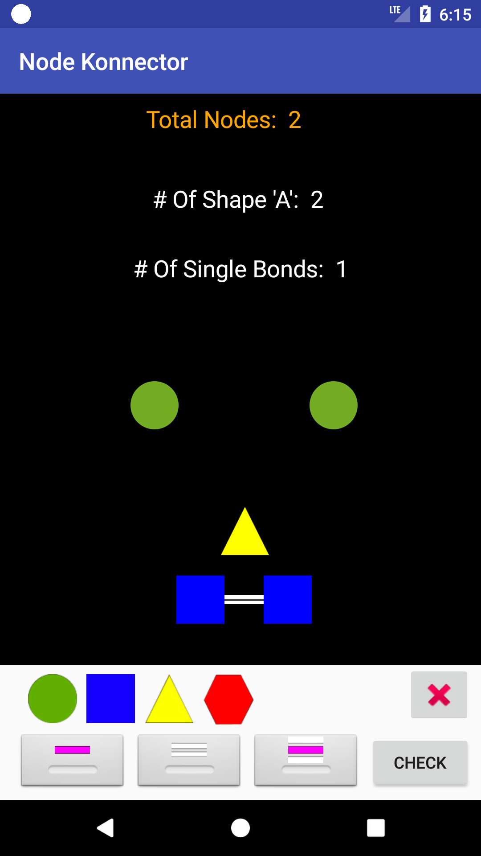
The Node Konnector Game
Game
Progress
Level
Selected

Slide 6
Facebook
Login
Save progress
We will only have your:
Email
User Name
Privacy Concerns:
Information only used and data is saved in Firebase.
Info is only share between Facebook friends you invite on the device (future implementation)

Slide 7
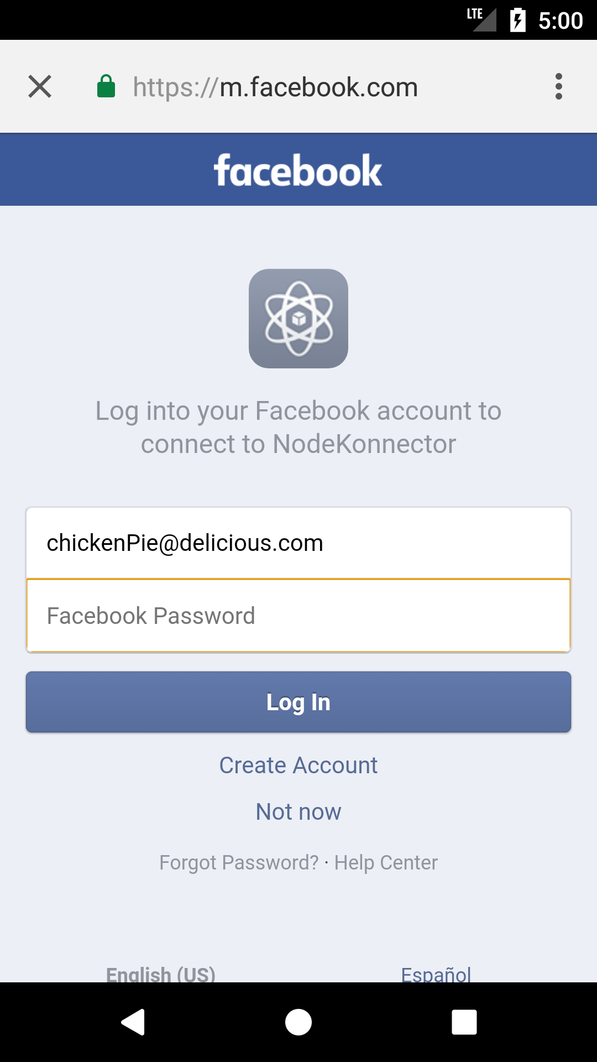
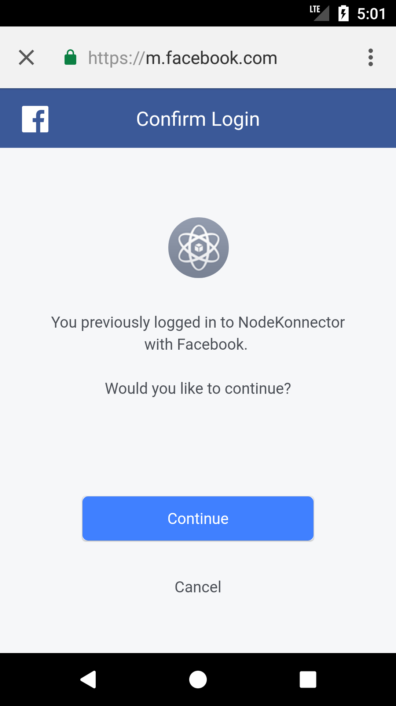
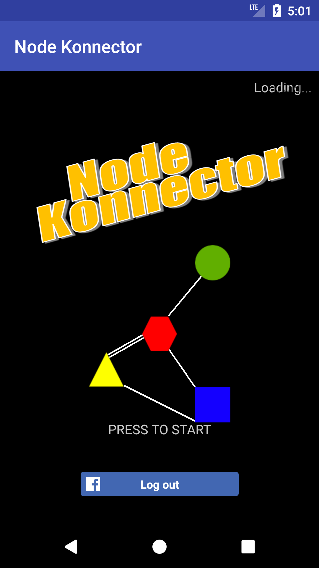
Facebook Login

Slide 8
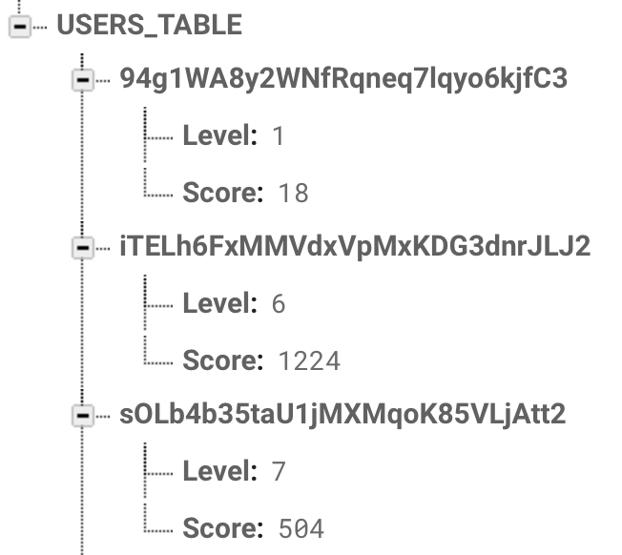
Firebase Data

Slide 9
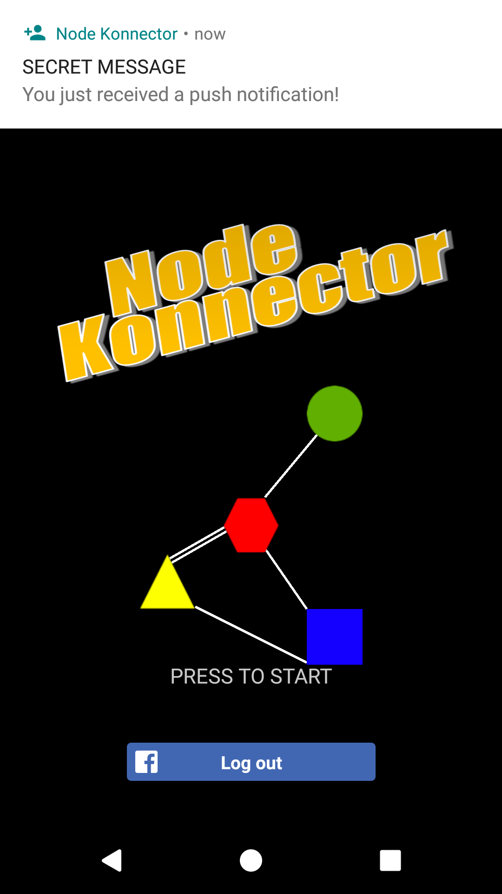
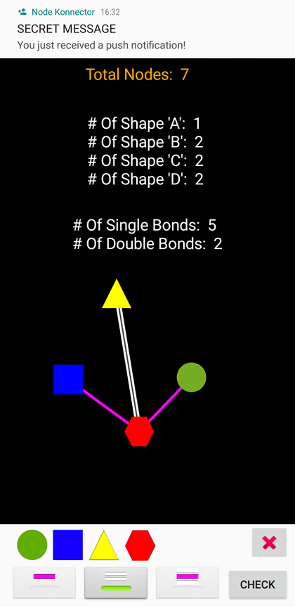
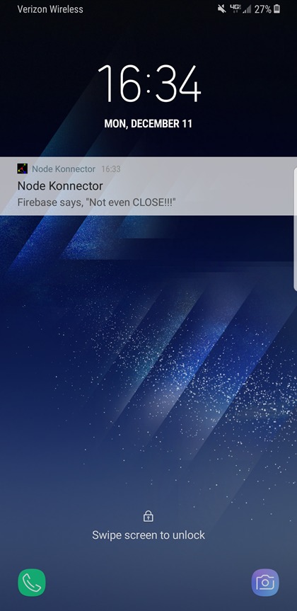
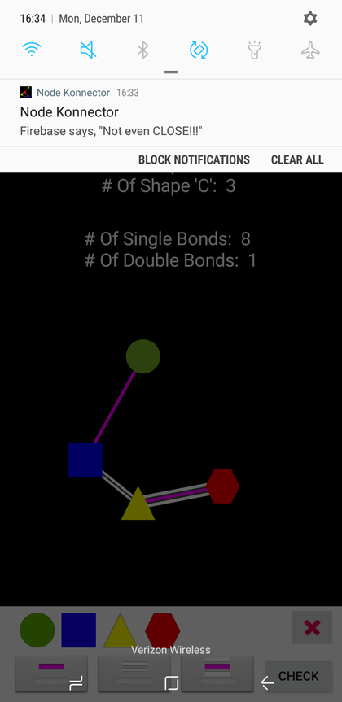
Push Notifications

Slide 10
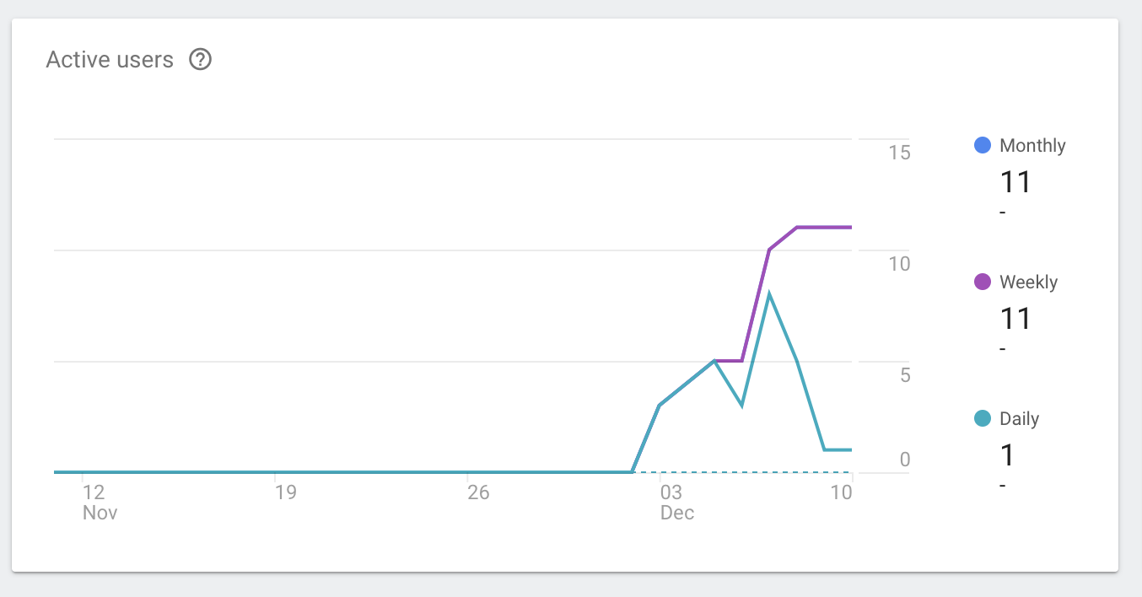
Active Users from Firebase Analytics

Slide 11
“Bond”
“Konnection”
“Nodes (Shapes)”
Link between two nodes/shapes
How much each bond is worth
SINGLE = 1 Konnection, DOUBLE = 2 Konnections, TRIPLE = 3 Konnections
CIRCLES = must have 1 Konnection
SQUARES = must have 2 Konnections HEXAGONS = must have 4
TRIANGLES = must have 3 Konnections Konnections

Slide 12



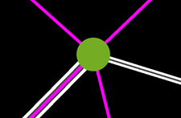

Shapes
Circles = 1 Konnection
BAD
GOOD

Slide 13
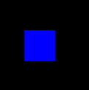
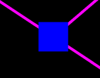

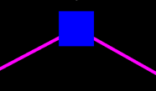

Squares = 2 Konnections
BAD
GOOD

Slide 14




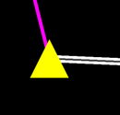
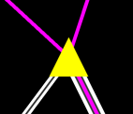
Triangles = 3 Konnections
BAD
GOOD

Slide 15
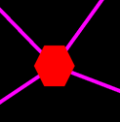
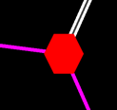
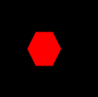
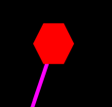

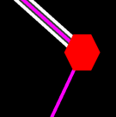
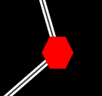
Hexagons = 4 Konnections
BAD
GOOD

Slide 16
“Bond”
“Konnection”
“Nodes (Shapes)”
Link between two nodes/shapes
How much each bond is worth
SINGLE = 1 Konnection, DOUBLE = 2 Konnections, TRIPLE = 3 Konnections
CIRCLES = must have 1 Konnection
SQUARES = must have 2 Konnections HEXAGONS = must have 4
TRIANGLES = must have 3 Konnections Konnections

Slide 17
DEMO!!!

Slide 18
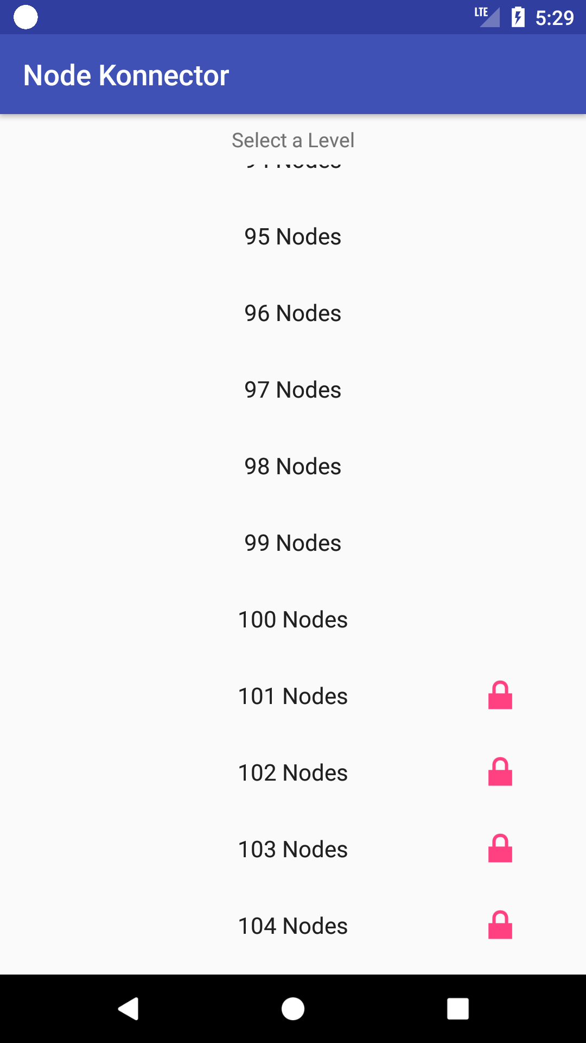
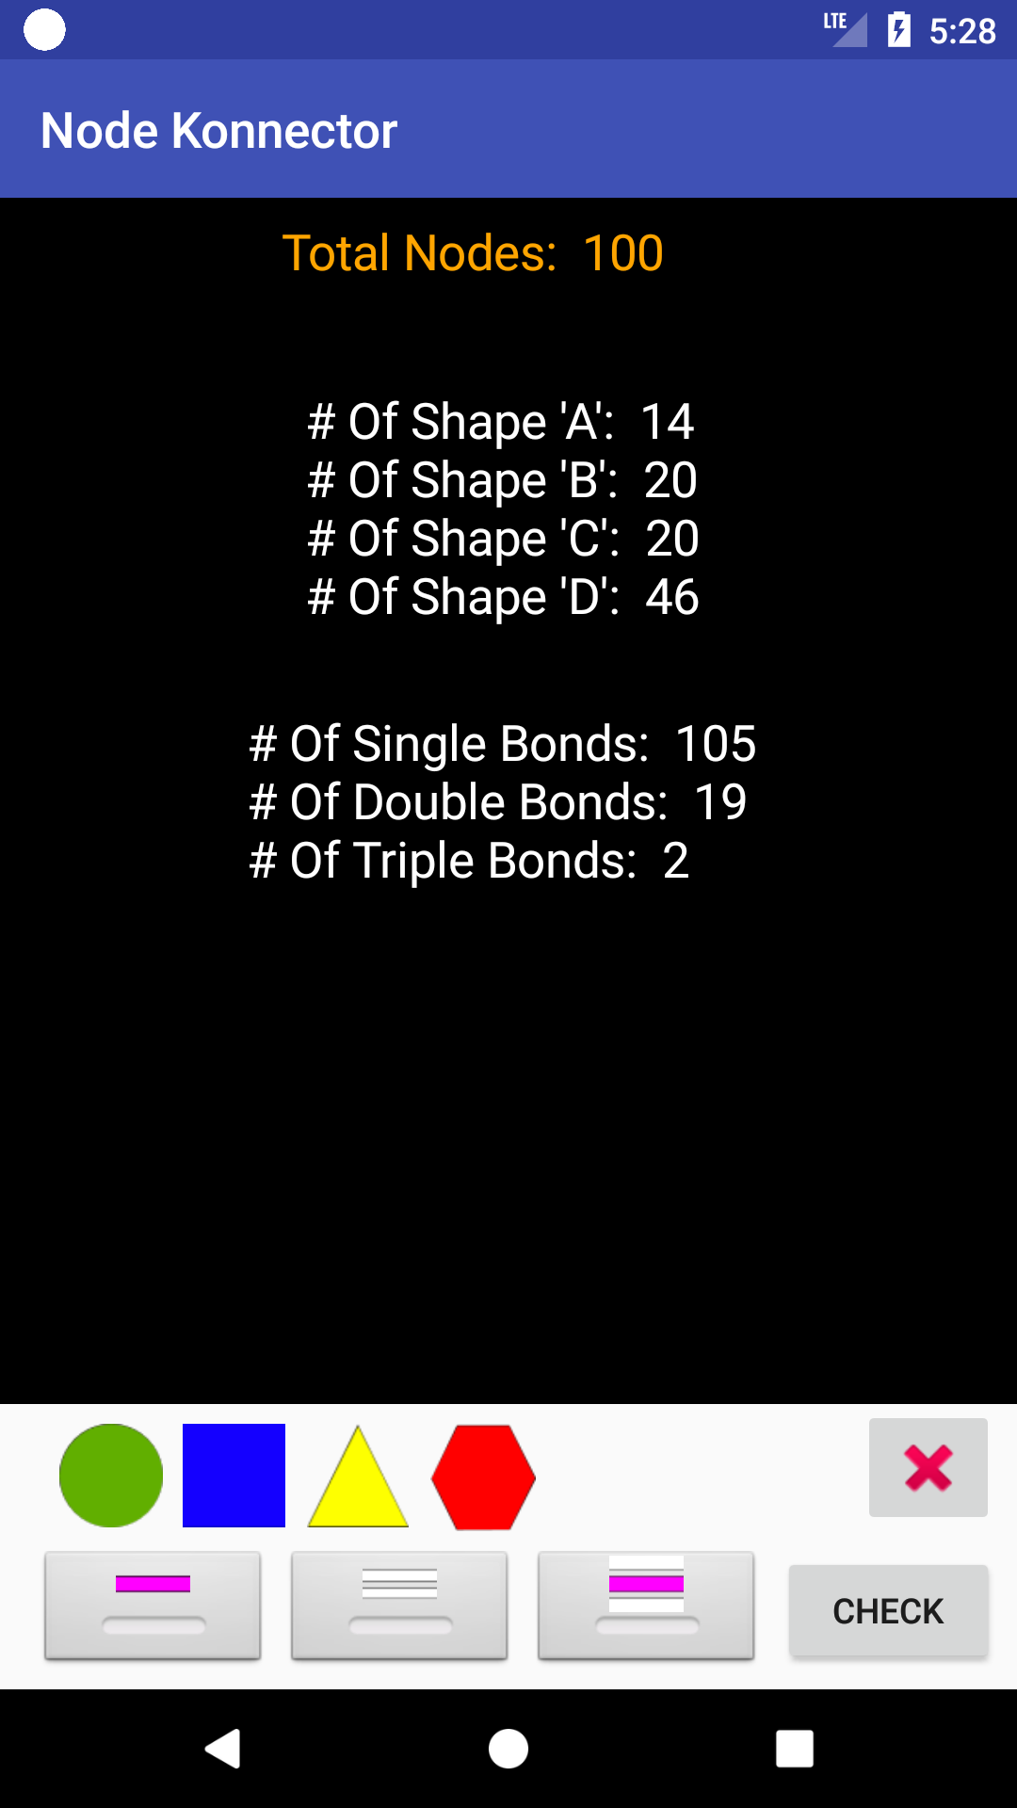
Try THIS one on for size…

